Slide 1
Syntax Analysis
Or
Parsing

Slide 2
Parsing
A.K.A. Syntax Analysis
Recognize sentences in a language.
Discover the structure of a document/program.
Construct (implicitly or explicitly) a tree (called as a parse tree) to represent the structure.
The above tree is used later to guide translation.

Slide 3
Parsing During Compilation
regular expressions
errors
lexical analyzer
token
rest of front end
intermediate representation
source program
parser
parse tree
get next token
symbol table
Collecting token information
Perform type checking
Intermediate code generation
uses a grammar to check structure of tokens
produces a parse tree
syntactic errors and recovery
recognize correct syntax
report errors
Notes:
‹#›

Slide 4
Parsing Responsibilities
Syntax Error Identification / Handling
Recall typical error types:
Lexical : Misspellings
Syntactic : Omission, wrong order of tokens
Semantic : Incompatible types, undefined IDs
Logical : Infinite loop / recursive call
Majority of error processing occurs during syntax analysis
NOTE: Not all errors are identifiable !!
if x<1 thenn y = 5:
if ((x<1) & (y>5)))
if (x+5) then
if (i<9) then ...
Should be <= not <
Notes:
‹#›

Slide 5
Error Detection
Much responsibility on Parser
Many errors are syntactic in nature
Modern parsing method can detect the presence of syntactic errors in programs very efficiently
Detecting semantic or logical error is difficult
Challenges for error handler in Parser
It should report error clearly and accurately
It should recover from error and continue..
It should not significantly slow down the processing of correct programs
Good news is
Common errors are simple and relatively easy to catch.
Errors don’t occur that frequently!!
60% programs are syntactically and semantically correct
80% erroneous statements have only 1 error, 13% have 2
Most error are trivial : 90% single token error
60% punctuation, 20% operator, 15% keyword, 5% other error

Slide 6
Adequate Error Reporting is Not a Trivial Task
Difficult to generate clear and accurate error messages.
Example
function foo () {
...
if (...) {
...
} else {
...
...
}
<eof>
Example
int myVarr;
...
x = myVar;
...
Missing } here
Not detected until here
Misspelled ID here
Not detected until here

Slide 7
Error Recovery
After first error recovered
Compiler must go on!
Restore to some state and process the rest of the input
Error-Correcting Compilers
Issue an error message
Fix the problem
Produce an executable
Example
Error on line 23: “myVarr” undefined.
“myVar” was used.
May not be a good Idea!!
Guessing the programmers intention is not easy!

Slide 8
Error Recovery May Trigger More Errors!
Inadequate recovery may introduce more errors
Those were not programmers errors
Example:
int myVar flag ;
...
x := flag;
...
...
while (flag==0)
...
Too many Error message may be obscuring
May bury the real message
Remedy:
allow 1 message per token or per statement
Quit after a maximum (e.g. 100) number of errors
Declaration of flag is discarded
Variable flag is undefined
Variable flag is undefined

Slide 9
Error Recovery Approaches: Panic Mode
Discard tokens until we see a “synchronizing” token.
The key...
Good set of synchronizing tokens
Knowing what to do then
Advantage
Simple to implement
Does not go into infinite loop
Commonly used
Disadvantage
May skip over large sections of source with some errors
Example
Skip to next occurrence of
} end ;
Resume by parsing the next statement

Slide 10
Error Recovery Approaches: Phrase-Level Recovery
Compiler corrects the program
by deleting or inserting tokens
...so it can proceed to parse from where it was.
The key...
Don’t get into an infinite loop
Example
while (x==4) y:= a + b
Insert do to fix the statement

Slide 11
Context Free Grammars (CFG)
A context free grammar is a formal model that consists of:
Terminals
Keywords
Token Classes
Punctuation
Non-terminals
Any symbol appearing on the lefthand side of any rule
Start Symbol
Usually the non-terminal on the lefthand side of the first rule
Rules (or “Productions”)
BNF: Backus-Naur Form / Backus-Normal Form
Stmt ::= if Expr then Stmt else Stmt

Slide 12
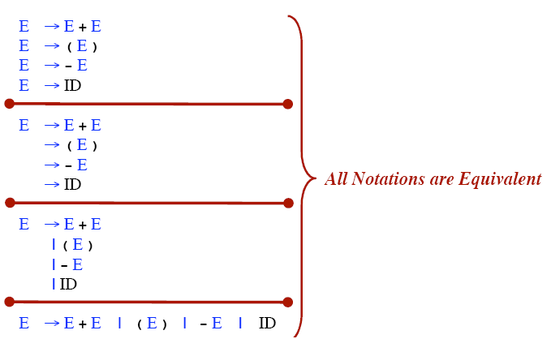
Rule Alternative Notations

Slide 13
Context Free Grammars : A First Look
assign_stmt → id := expr ;
expr → expr operator term
expr → term
term → id
term → real
term → integer
operator → +
operator → -
Derivation: A sequence of grammar rule applications and substitutions that transform a starting non-term into a sequence of terminals / tokens.
Notes:
‹#›

Slide 14
Derivation
Let’s derive: id := id + real – integer ;
using production:
assign_stmt assign_stmt → id := expr ;
→ id := expr ; expr → expr operator term
id := expr operator term; expr → expr operator term
id := expr operator term operator term; expr → term
id := term operator term operator term; term → id
id := id operator term operator term; operator → +
id := id + term operator term; term → real
id := id + real operator term; operator → -
id := id + real - term; term → integer
id := id + real - integer;
Notes:
‹#›

Slide 15
Example Grammar: Simple Arithmetic Expressions
expr → expr op expr
expr → ( expr )
expr → - expr
expr → id
op → +
op → -
op → *
op → /
op → ↑
9 Production rules
Terminals: id + - * / ↑ ( )
Nonterminals: expr, op
Start symbol: expr
Notes:
‹#›

Slide 16
Notational Conventions
Terminals
Lower-case letters early in the alphabet: a, b, c
Operator symbols: +, -
Punctuations symbols: parentheses, comma
Boldface strings: id or if
Nonterminals:
Upper-case letters early in the alphabet: A, B, C
The letter S (start symbol)
Lower-case italic names: expr or stmt
Upper-case letters late in the alphabet, such as X, Y, Z, represent either nonterminals or terminals.
Lower-case letters late in the alphabet, such as u, v, …, z, represent strings of terminals.

Slide 17
Notational Conventions
Lower-case Greek letters, such as α, β, γ, represent strings of grammar symbols. Thus A→ α indicates that there is a single nonterminal A on the left side of the production and a string of grammar symbols α to the right of the arrow.
If A→ α₁, A→ α₂, …., A→ α_{k} are all productions with A on the left, we may write A→ α₁ | α₂ | …. | α_{k}
Unless otherwise started, the left side of the first production is the start symbol.
E → E A E | ( E ) | -E | id
A → + | - | * | / | ↑

Slide 18
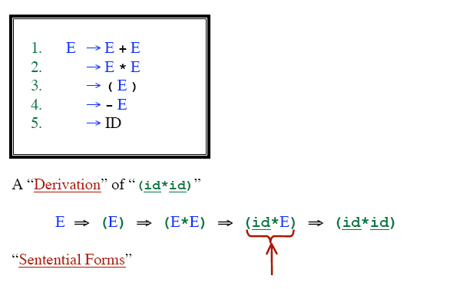
Derivations
Doesn’t contain nonterminals

Slide 19
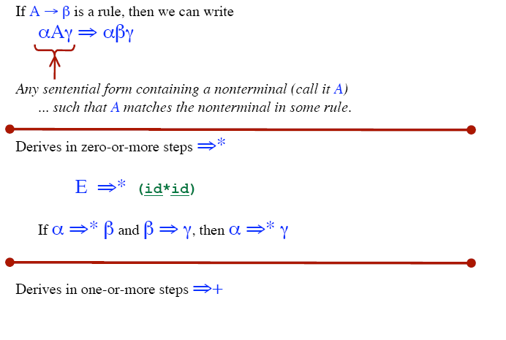
Derivation

Slide 20
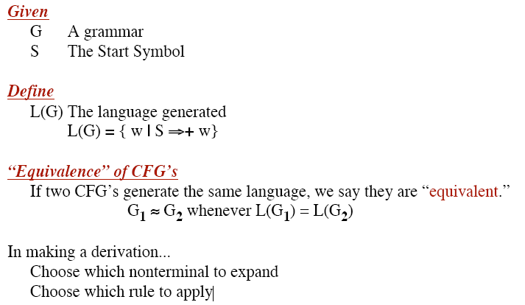

Slide 21
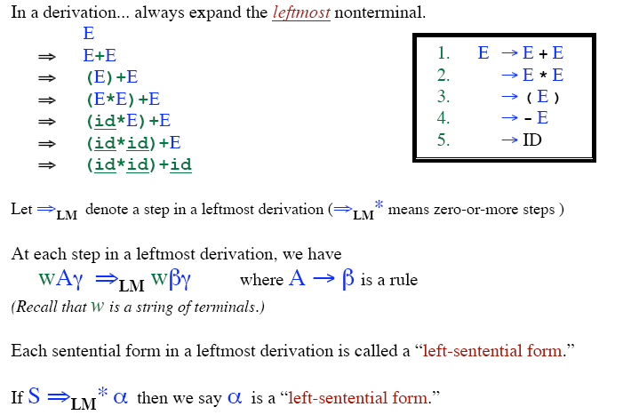
Leftmost Derivation

Slide 22
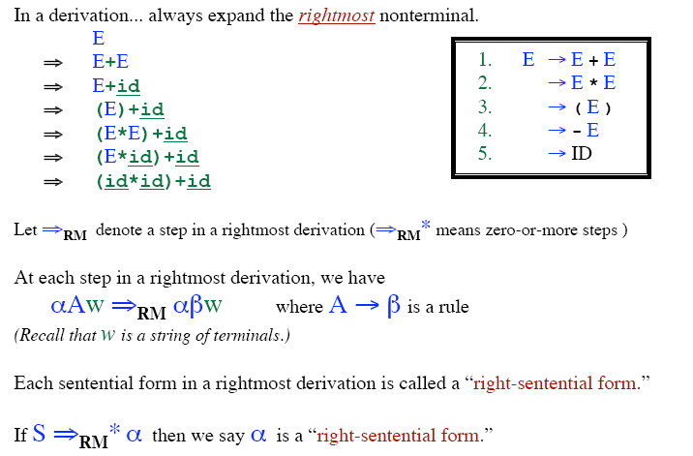
Rightmost Derivation

Slide 23
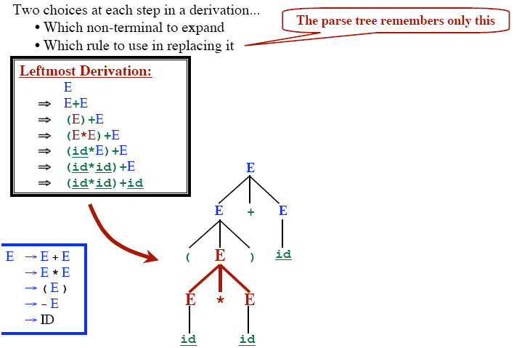
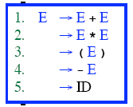
Parse Tree

Slide 24
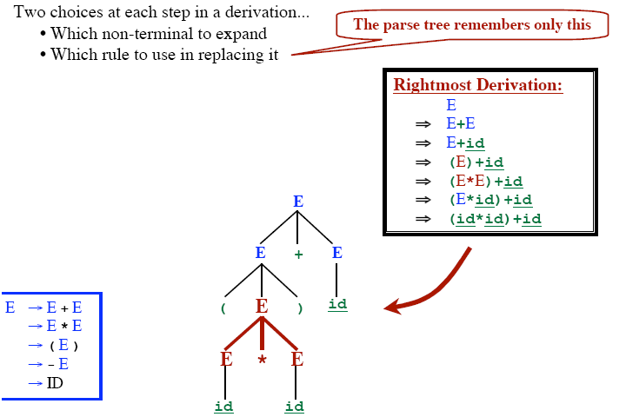
Parse Tree

Slide 25
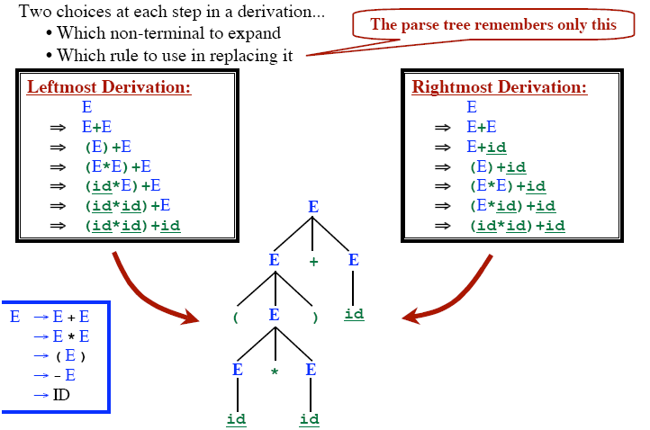

Parse Tree

Slide 26
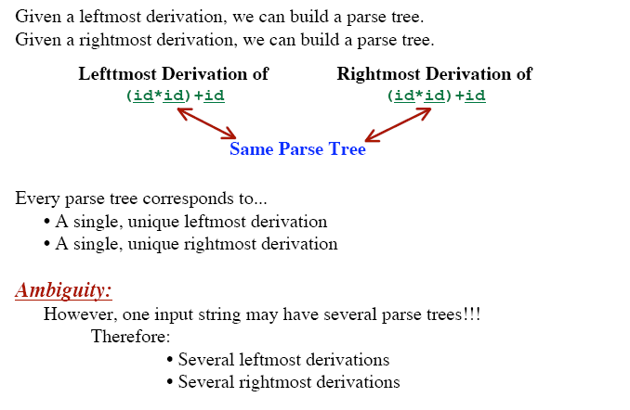
Parse Tree

Slide 27
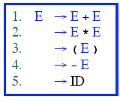
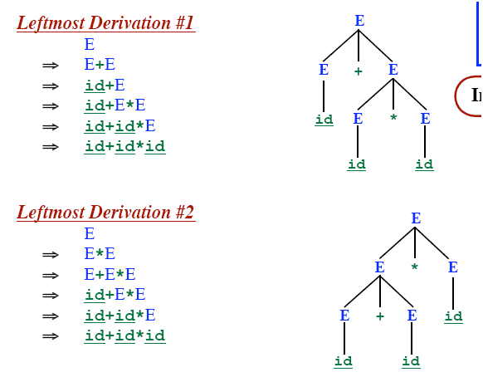

Ambiguous Grammar

Slide 28
Ambiguous Grammar
More than one Parse Tree for some sentence.
The grammar for a programming language may be ambiguous
Need to modify it for parsing.
Also: Grammar may be left recursive.
Need to modify it for parsing.

Slide 29
Elimination of Ambiguity
Ambiguous
A Grammar is ambiguous if there are multiple parse trees for the same sentence.
Disambiguation
Express Preference for one parse tree over others
Add disambiguating rule into the grammar

Slide 30
Resolving Problems: Ambiguous Grammars
Consider the following grammar segment:
stmt → if expr then stmt
| if expr then stmt else stmt
| other (any other statement)
If E1 then S1 else if E2 then S2 else S3
simple parse tree:
stmt
if
expr
then
stmt
else
stmt
E₁
S₁
expr
then
stmt
else
stmt
if
E₂
S₂
S₃
Notes:
‹#›

Slide 31
Example : What Happens with this string?
If E₁ then if E₂ then S₁ else S₂
How is this parsed ?
if E₁ then
if E₂ then
S₁
else
S₂
if E₁ then
if E₂ then
S₁
else
S₂
vs.
Notes:
‹#›

Slide 32
Parse Trees: If E1 then if E2 then S1 else S2
Form 1:
stmt
if
expr
then
stmt
E₁
stmt
else
stmt
if
expr
then
E₂
S₁
S₂
Form 2:
stmt
if
expr
then
stmt
else
stmt
E₁
expr
then
stmt
S₂
if
E₂
S₁
Notes:
‹#›

Slide 33
Removing Ambiguity
Take Original Grammar:
stmt → if expr then stmt
| if expr then stmt else stmt
| other (any other statement)
Rule: Match each else with the closest previous unmatched then.
Revise to remove ambiguity:
stmt → matched_stmt | unmatched_stmt
matched_stmt → if expr then matched_stmt else matched_stmt | other
unmatched_stmt → if expr then stmt
| if expr then matched_stmt else unmatched_stmt
Notes:
‹#›

Slide 34
Any Question?

